Slide 1

Java for Beginners
Level 1
M. Teasdale

Slide 2
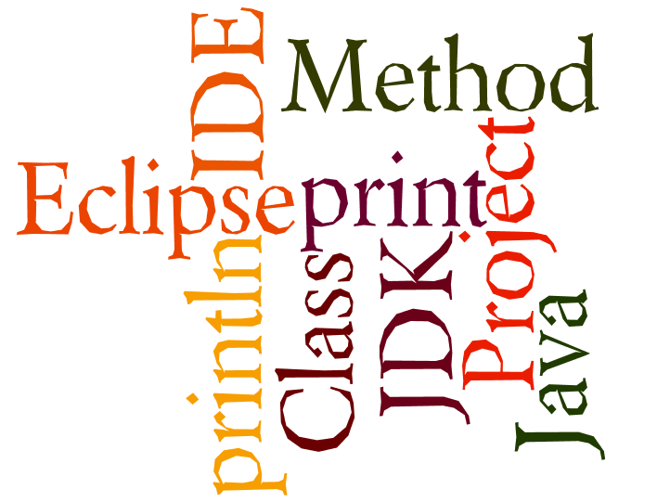
What do you learn last time?
Wordle.org

Slide 3
3 Laws of Java
Every line ends with a ; unless the next symbol is a {
Every { has a }
Classes start with capital letters, methods and variables start with lower case letters

Slide 4

Java’s structure
Java programs are called ‘classes’
They exist inside a container called a project
All classes have at least one method called main()
Project: CheeseCake
Class: CheeseCake
Method: main()
We write our ‘code’ here

Slide 5
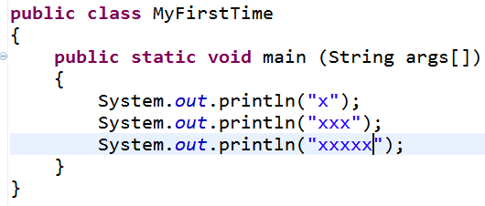
Java class example
Class name
Main method

Slide 6
Levels of Java coding
1: Syntax, laws, variables, output
2: Input, calculations, String manipulation
3: Selection (IF-ELSE)
4: Iteration/Loops (FOR/WHILE)
5: Complex algorithms
6: Arrays
7: File management
8: Methods
9: Objects and classes
10: Graphical user interface elements

Slide 7
Variables vs. Value
A variable is like a box
What is inside the box can change or ‘vary’
The ‘thing’ inside the box is the value

Slide 8

5 types of variables
double
boolean
int
char
String

Slide 9
Why not have just 1 type?
Only type big enough to cope with sentences is Strings
Strings are BIG compared with booleans/ints
To save space, we only use the box type that is “just big enough” to contain the value we want.
Less waste = faster programs!

Slide 10
Strings: “cat” “DA1 2HW”
double
boolean
int
char
String

Slide 11
int: 23 0 -98 39290 -321
double
boolean
int
char
String

Slide 12
double: 1.2 -5.93 3.3333
double
boolean
int
char
String

Slide 13
boolean: true / false
double
boolean
int
char
String

Slide 14
char: ‘a’ ‘3’ ‘@’ ‘A’ ‘ ’
double
boolean
int
char
String

Slide 15
What data type is each of the following?
double
-9
4.5
chicken
false
%
£ 2.90
The cat is hungry now.
192.168.1.190
boolean
int
char
String

Slide 16
Declare vs. Instantiate
_{Declare}
int number;
number = 3;
int number = 3;
_{Instantiate}
All in one!

Slide 17
Strings
_{Declare}
String name;
name = “Joe”;
String name = “Joe”;
_{Instantiate}
All in one!

Slide 18
char
_{Declare}
char letter;
letter = ‘a’;
char letter = ‘a’;
_{Instantiate}
All in one!

Slide 19
double
_{Declare}
double price;
price = 2.99;
double price = 2.99;
_{Instantiate}
All in one!

Slide 20
boolean
_{Declare}
boolean fit;
fit = true;
boolean fit = true;
_{Instantiate}
All in one!

Slide 21
Be careful!
true vs “true”
“a” vs ‘a’
“4” vs 4
“2.99” vs 2.99
+ vs ‘+’ vs “+”
Note! Strings cannot do calculations

Slide 22
What does this do?
int num;
num = 23;
System.out.println(23);
System.out.println(num);
System.out.println(“23”);
Output
23
23
23

Slide 23

Combining values and variables
int num1 = 5;
int num2 = 10;
System.out.println(num1+num2);
System.out.println(num1+” + ”+num2);
Output
15
5 + 10

Slide 24
What went wrong?!
String number = “2”;
int zombie = 4;
System.out.println(number+number);
System.out.println(zombie+zombie);
Output
22
8

Slide 25
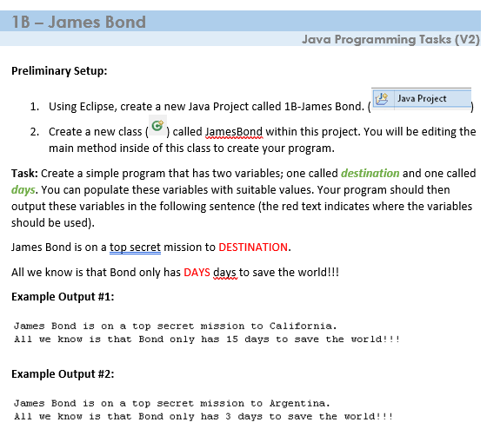
Submit your code into onenote along with the output

Slide 26
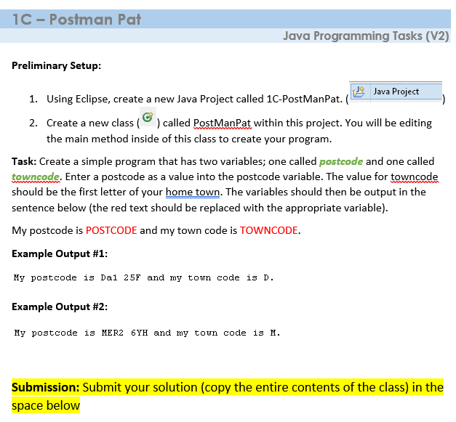
Submit your code into onenote along with the output

Slide 27
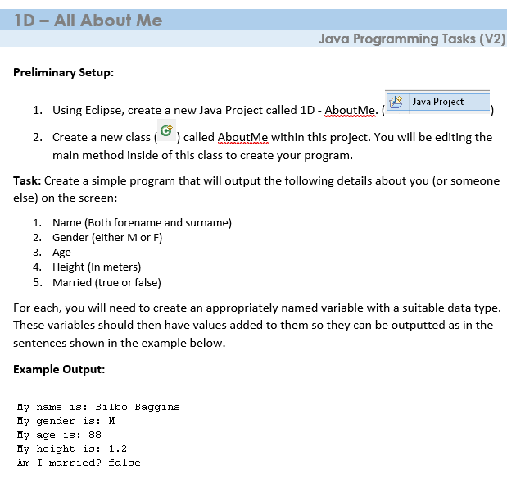
Submit your code into onenote along with the output

